Slide 1
Billy's Bucket List
Create more 3D models
    Critical: customer requested a basket
  Unify Unity project
  Post Sprint 7
  Ensure intro video plays
  Ensure all assets and scripts are operational
  Compile into an executable

Slide 2
Billy's Accomplishments
Create more 3D models
Unification – everything is finally in one project (hopefully)
  Unification happened late in the sprint
  Roadblock of CSC309

Slide 3
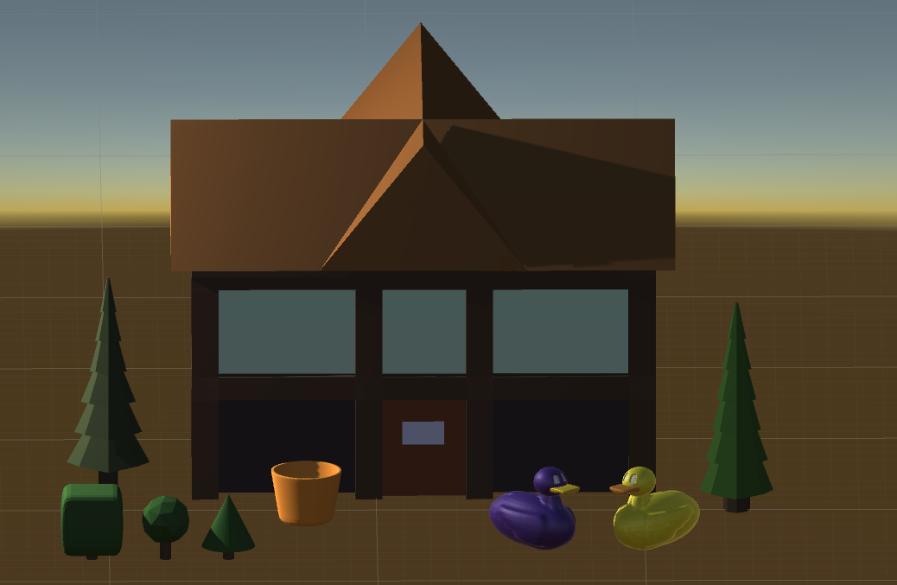
Billy's Accomplishments

